Slide 1
Cluster legal environment in Hungary
Project “Enhancing capacity of universities to initiate and to participate in clusters development on innovation and sustainability principles” (UniClaD)
Program Erasmus +, project KA2 n° 609944-EPP-1-2019-1-LT-EPPKA2-CBHE-JP
István Komlósi
University of Debrecen

Slide 2
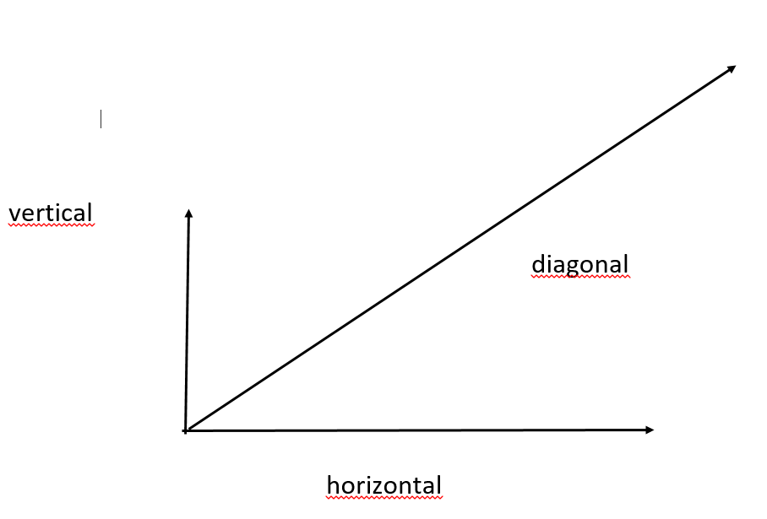
Types of clusters

Slide 3
Foundation of cluster
Members have already had working experience with each other
Mutual TRUST
Intrinsic, voluntary interest
Agree on common objectives
Structure is not fixed, flexible network
Not the legal contract that makes the cluster work
Can be established on verbal, written agreement or implicitly accepts
The written agreement is cooperation agreement or syndicate contract
The form of organisation can be cooperative, association, business association, foundation, civic association,…

Slide 4
In the agreement…define
What are the objectives
What are the activities
What are the assets, means for carrying out the activities
How the members contribute to carry out the activities
What are the rights and liabilities of the members
Who and how can make deceisions (person, board)
Levels of deceision making
Composition of board (possibility to change)
Can the deed of foundation be changed?

Slide 5
In the agreement…define
Rules for admission of new members and exclusion, exit of members
Termination of cluster
The utilisation of common resources, sharing of costs, fees, sanctions
Rights to the profit, sharing of debts
Ethical norms, responsibility in common matters
Participation in project calls
Event organisations
Settlement of dispute
Confidentiality of business secrets

Slide 6
Cluster management (CM)
Separate entity and not one of the member
Define the duties, services of the CM
Who controls the CM (general assembly, board,…)
How much is the remuneration of the CM
How to resolve debate
Business secrets
Communication
Commanding rights
Representation of the cluster
Can be a business organisation (for-profit, non-profit)
Member can not have dominant influence on CM

Slide 7
Accreditaion of clusters
Min. 20 members
Transparency in startegy and in operation
Efficiency in collaboration
3< years R+I+D activity
Incubation, mentoring and international activity, export potential
Concentrated in neighbouring counties
European Secretariat for Cluster Analysis
https://cluster-analysis.org/

